Slide 1


NWA
Automatic Meter Reading System

Slide 2
Introduction
The main objective of this project is to eliminate the human errors in process of data collection about household electricity usage reading for the purpose of bill calculation.
Along with introduction of Pre-paid and Post-paid models for electricity distribution.

Slide 3
Problem Definition (Reason why you chose this Problem Statement)
The traditional system which is manual.
Bills are calculated on average usage which is inappropriate.
Currently electricity is provided only through post-paid system.
Inevitable circumstances.
Human errors

Slide 4
Existing System (Optional)
Traditional working system is manual process
Prone to human errors
Large delays in process
Inefficient

Slide 5
Proposed Solution
Post-paid system:
All these human errors and inevitable circumstance can be handled very easily by introducing the automation to the process of data gathering. A simple external device can be installed besides the meters in every house which will be connected to the internet and will transmit the data direly to the service provider’s server in order to calculate the bill without any human interaction.
Pre-paid system:
User can control his/her usage by recharging the electric meter with desired amount and utilize it accordingly. Once the recharge is over user can repeat the process.

Slide 6
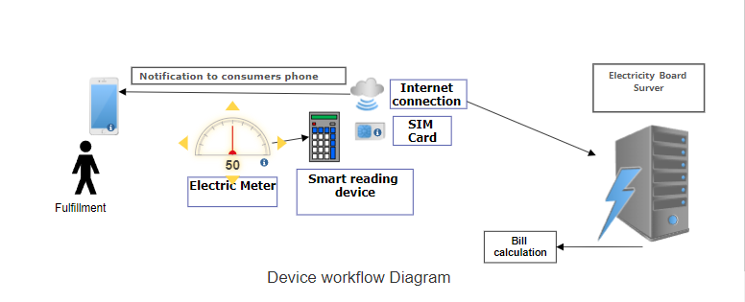
Architecture / Flow Chart

Slide 7
Hardware and Software Technology Used
Arduino for ATmega328P microcontroller
Esp8266 for internet connectivity
GSM 8000L SMS module for Prepaid system
Arduino IDE for code development
Relay module
Limit switches
IOT platform
ML model (Python Language)

Slide 8
Future Scope
There are almost 250 million electronic meters presented all over the India, out of which 28.4 million users are present in Maharashtra. Installation of this system in these 28.4 million houses will lead to massive improvement in work flow of electricity board that too without disturbing pre-established meter system, resulting in more accurate bill calculation in less cost.

Slide 9
Thank You

